Slide 1
Atlas intro and setup
MongoDB Atlas
Notes:
Release: 20240216

Slide 2
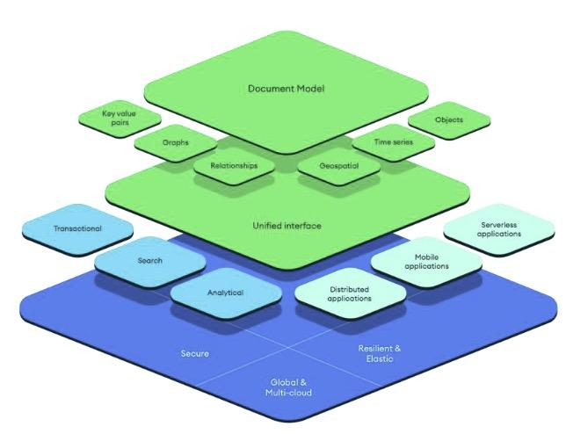

MongoDB Atlas Platform
Developer data platform that extends beyond fully managed MongoDB to help building modern applications

Slide 3
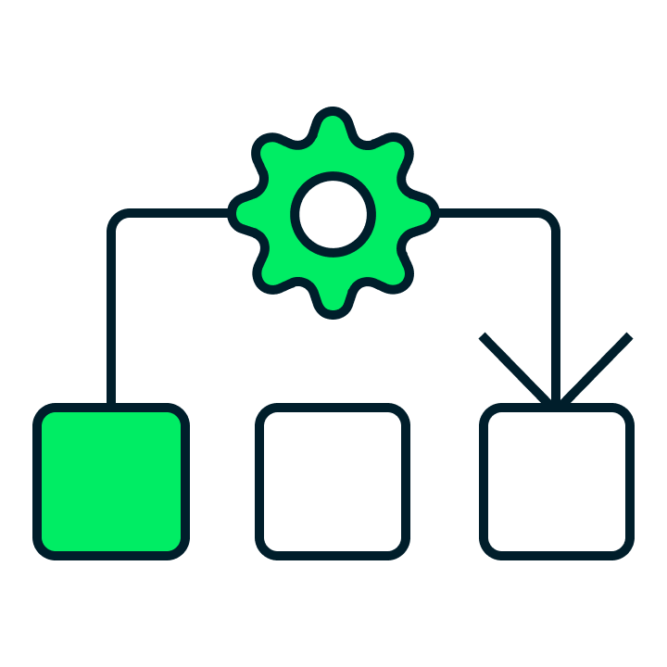

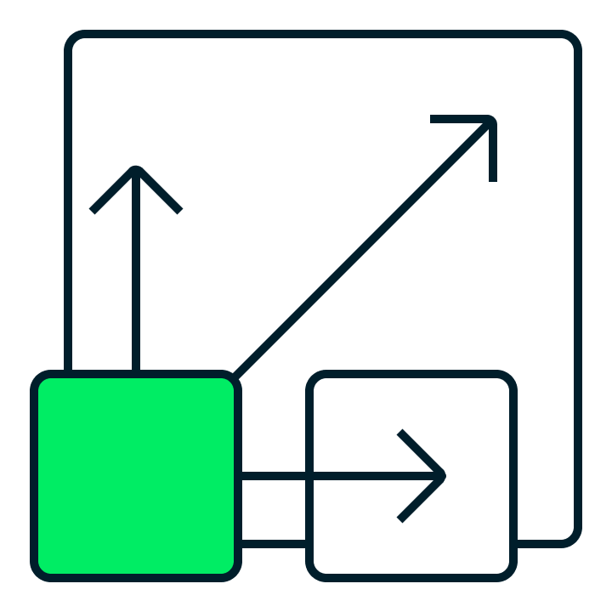
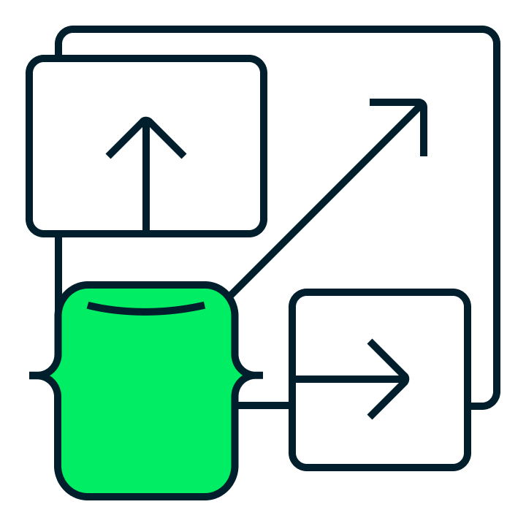







MongoDB Atlas - Multi-Cloud DBaaS
Core Database-as-a-Service features
Fully managed database lifecycle including continuous availability backed by SLA, point-in-time recovery, and more
Multi-cloud, global data distribution for low-latency data access, data sovereignty, cross-region/cloud failover, and more
Fully elastic deployments with on-demand vertical and horizontal scaling
Autopilot features, including bidirectional auto-scale, intelligent performance optimization and automatic index advice
Up-to-date security defaults, enterprise security controls, and compliance offerings (ISO 27001 · SOC 2 · PCI-DSS · HIPAA)
Powerful end user privacy protection with client-side field-level encryption
Pay-as-you-go, consumption-based pricing
Improve efficiency by auto-tiering historical data to queryable archival storage

Slide 4


Cluster Topology
Replica Set
High Availability via Replica Sets
Multiple copies of all data
Different hosts / locations
Continuous replication
Scale via Shards
Partition data over multiple Replica Sets
Provides unlimited hardware scaling
High availability - Replication
Shard 1
Shard 2
… Shard N
Horizontal scalability - Sharding

Slide 5
Terminology
RDBMS
Database
Table
Row
Column
Index
Database
Collection
Document
Field
Index
MongoDB
Namespace

Slide 6
Feature | MongoDB | Relational Database
Data Model | Schema-less, document-oriented | Structured, tabular (tables)
Schema Design | Flexible schema, dynamic data structure | Fixed schema, predefined data structure
Data Relationships | Referencing, supports nested documents(embedded documents) | Normalized, supports foreign keys, joins
Transaction Support | Limited multi-document transactions | ACID transactions across multiple tables
Data Integrity | Eventual consistency, flexible constraints | Strong consistency, enforced integrity rules
Scalability | Horizontal scaling (sharding) | Vertical scaling (adding more resources)
Data Migration | May require data transformation and migration due to schema changes | Straightforward migration between compatible databases

Slide 7
Feature | MongoDB | Relational Database
Data Size Limitation | MongoDB imposes a maximum document size limit (typically 16 MB), which can be restrictive for certain use cases involving large documents | No limitation on data size
Data Consistency | Eventual consistency model. Read operations may return stale data in distributed environments until data is propagated across all nodes. | Strong consistency model. Transactions ensure data consistency and integrity, with changes visible immediately across all nodes.
Complexity of Operations | Operational complexity due to distributed systems management | Management complexity typically lower, well-established best practices
Community Support | Active community, forums, and documentation | Established community, extensive documentation
Vendor dependency | Tied to MongoDB's ecosystem and features | Relatively vendor-agnostic, easier to switch databases

Slide 8
Deployment Options

Slide 9

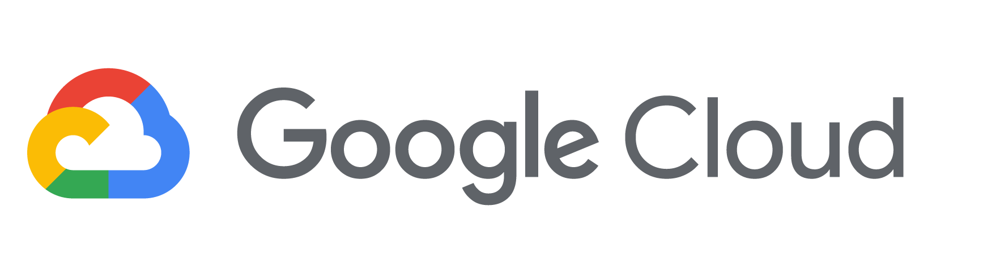

Cloud Providers
MongoDB Atlas is available on all three major clouds

Slide 10
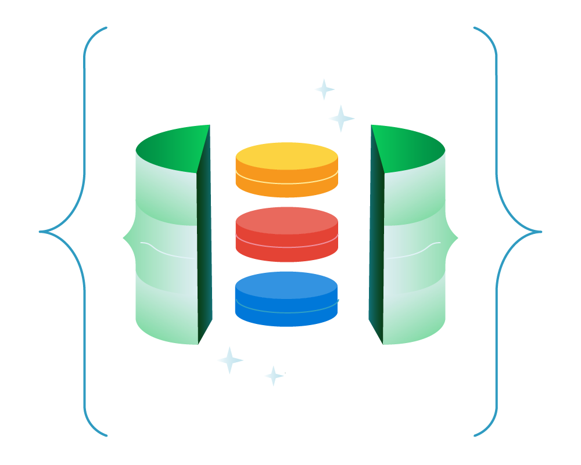
Multi-Cloud Clusters
Deploy a single cluster across multiple clouds:
Ensure High availability with cross-cloud replication
Migrate clusters from one cloud to another
Take advantage of technology across multiple clouds
Reach more users by distributing the database across more regions

Slide 11
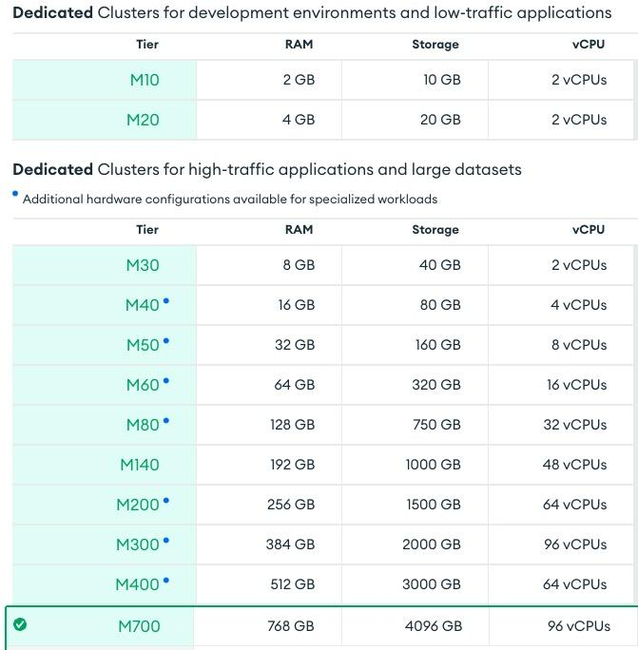
Cluster Tier
Choose your cluster tier
Shared
Dedicated, low-traffic
Dedicated, high-traffic
Severless
Fine-tune with tier options
Class
Storage
Auto-scale
IOPS
Network resources determined by the tier

Slide 12
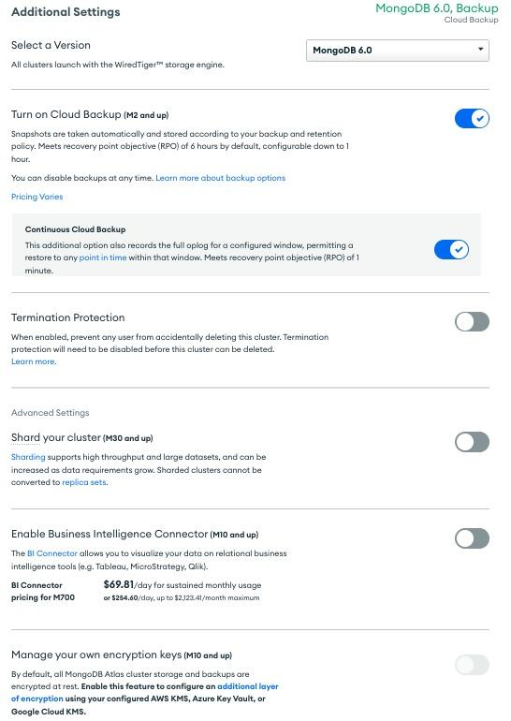
Additional Settings
MongoDB version
Backup
Sharding
BI Connector
Encryption key management
And more…

